Slide 1

CSC120 LAB – COMPUTER PROGRAMMING 1
WEEKLY LAB
Everett

Slide 2

WEEK 3 – LAB 2
CSC120
LAB
Monday 1/26/2025
Using Variable & Receiving Inputs
(I.P.O.)
Part 1: Solving a System of Linear Equations with Two Unknowns
Part 2: Shopping at a Cafe
Lab Instructor:
Dr. Hien Nguyen

Slide 3
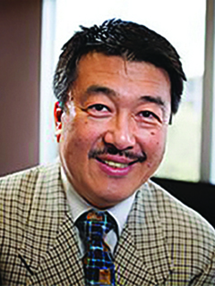
CSC120 Lecture Professor
Dr. Mitsunori Ogihara
Professor
Office: Ungar Building, Room 310F
E-mail: mogihara@miami.edu
Office Hours: T
https://people.miami.edu/profile/9930bd3ea82f8adb34c87a31680b79c4

Slide 4

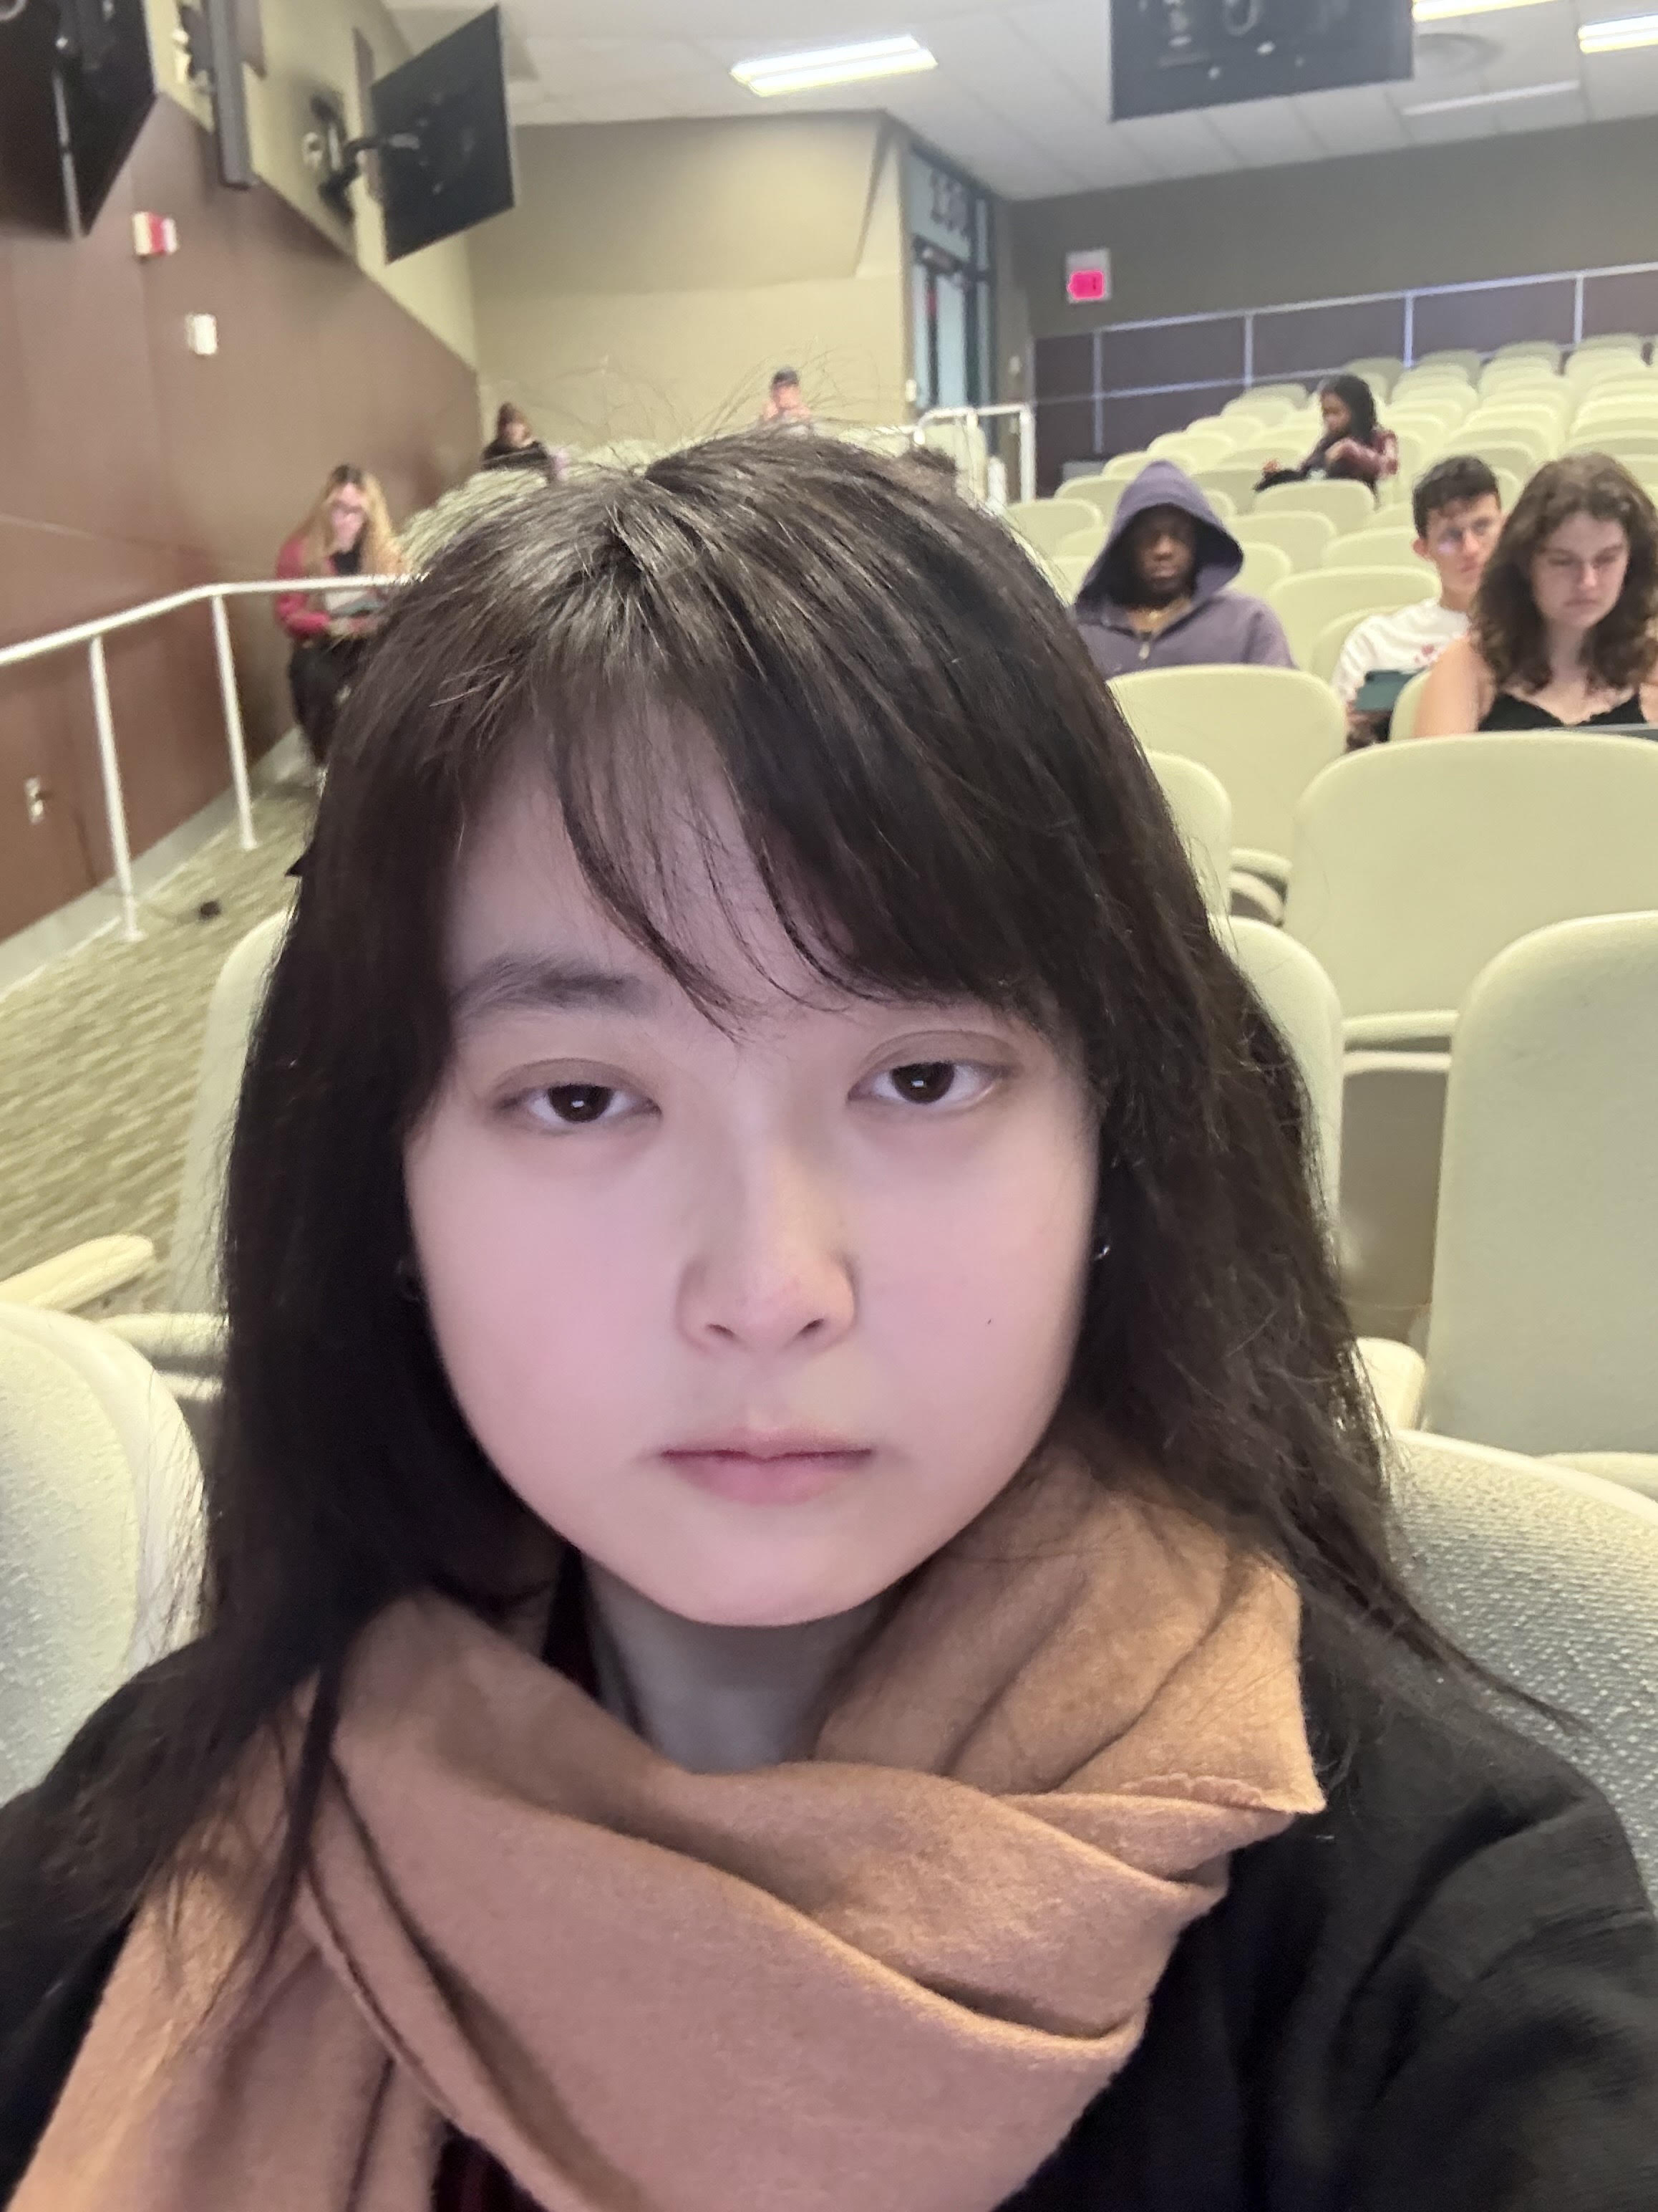
LAB Instructor & TAs
Everett
Teaching Assistant
Office: Ungar Building, Room 310T
E-mail:yxx644@miami.edu
Office Hours: Wednesday 11am - 3pm

Slide 5
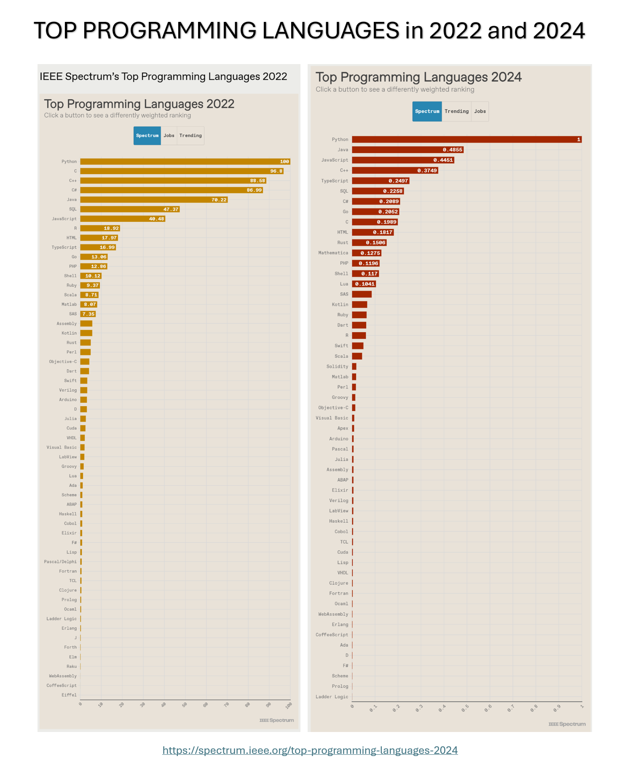
FUN FACT
& RESOURCES

Slide 6
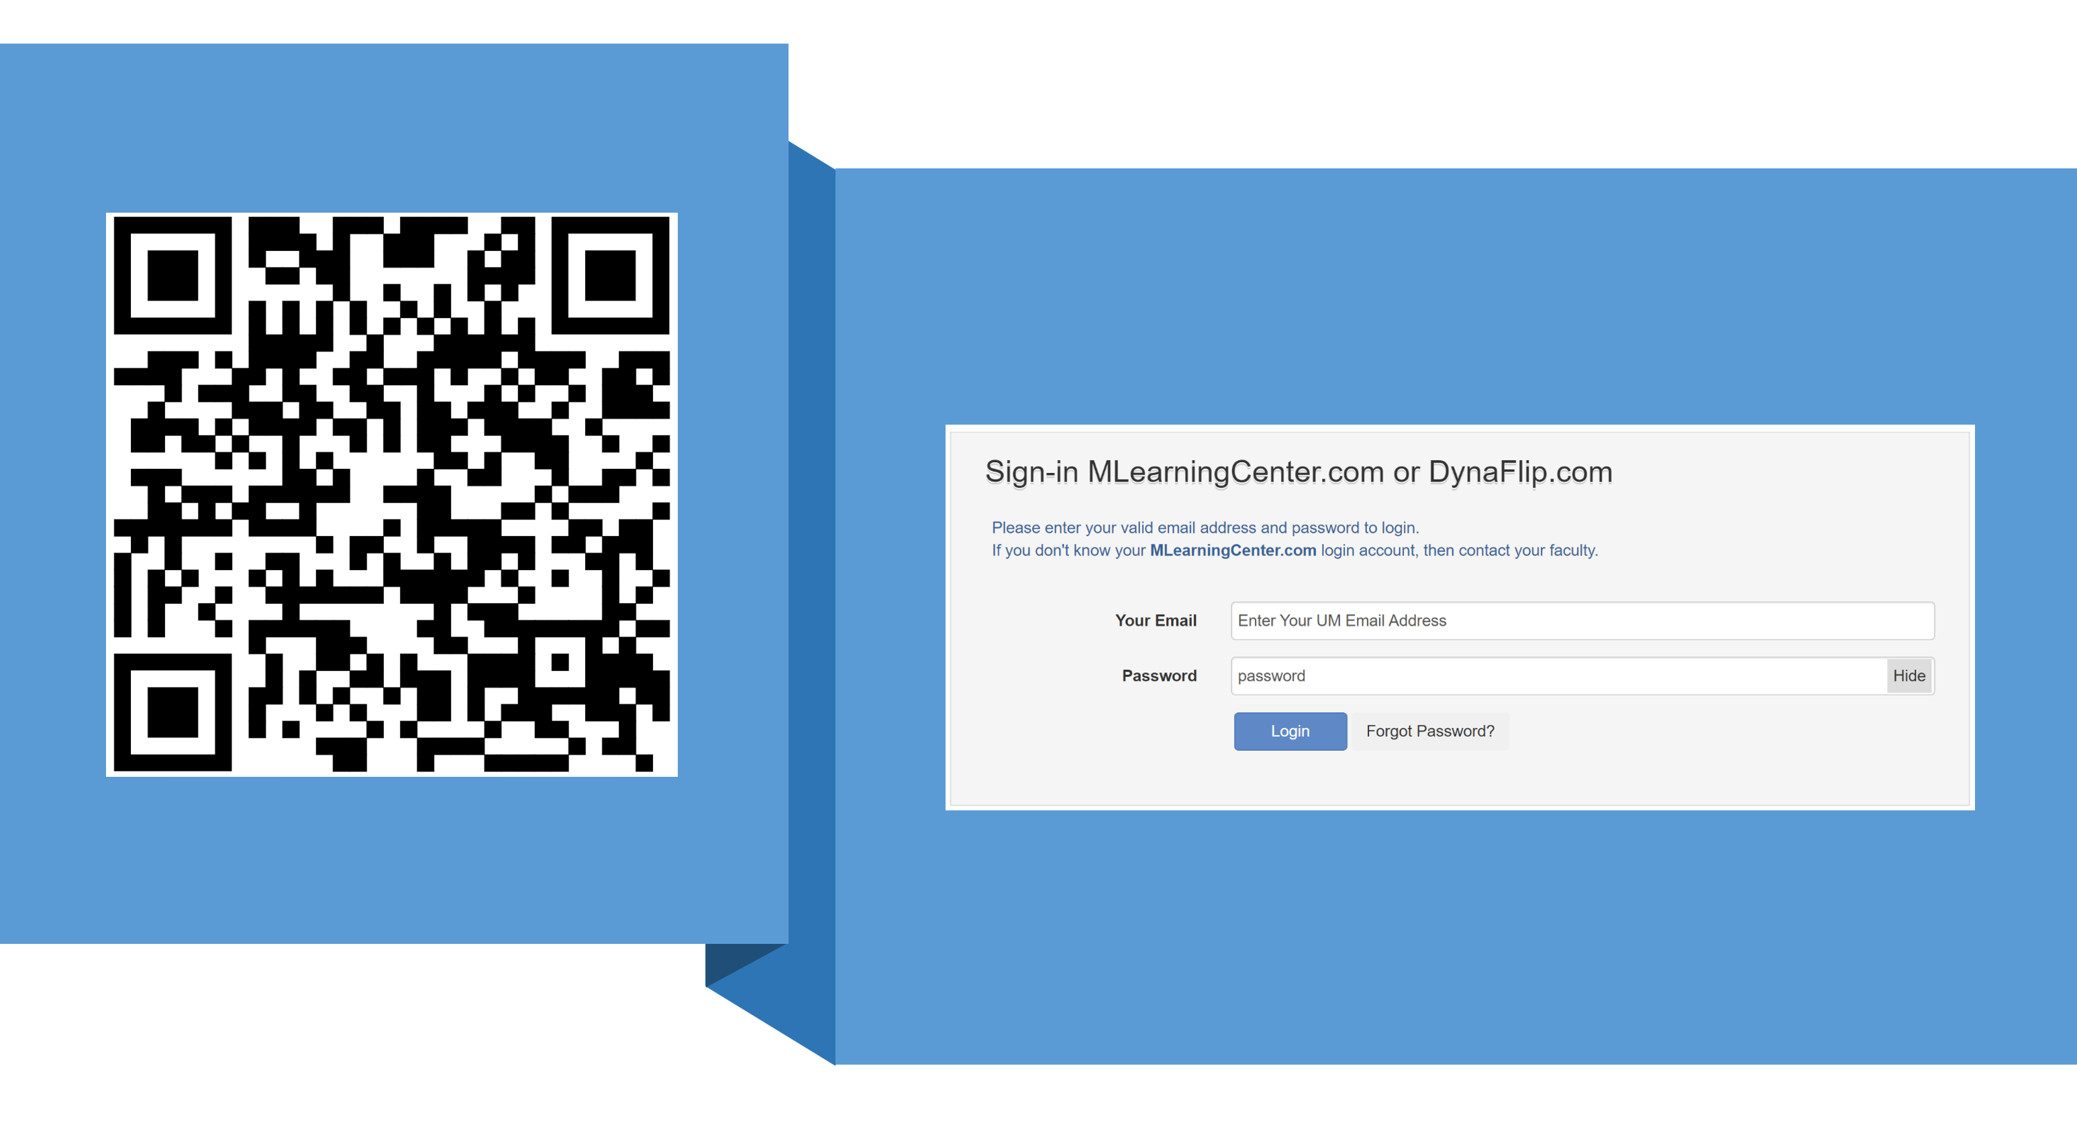
Taking Attendance

Slide 7
Remind of FIRST WEEK LAB WORK

Slide 8

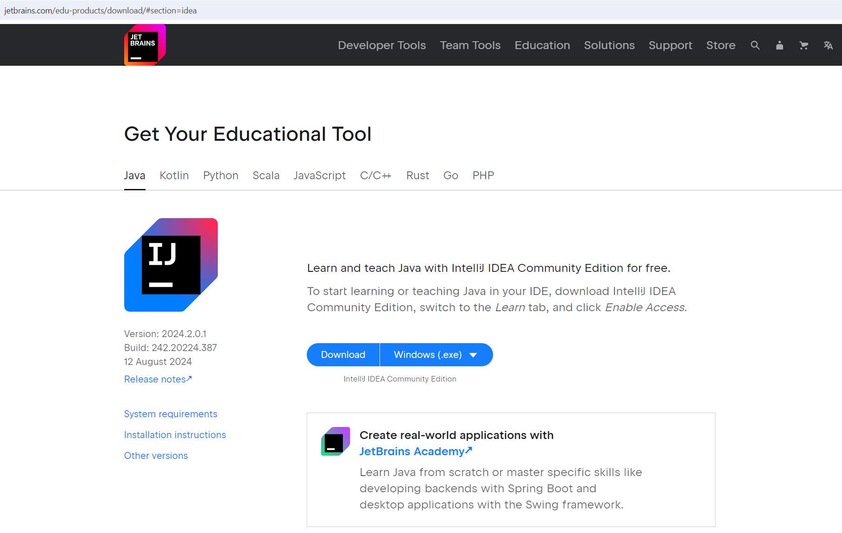
THIS IS THE DIRECT LINK TO DOWNLOAD
https://www.jetbrains.com/edu-products/download/#section=idea
IntelliJ IDEA

Slide 9
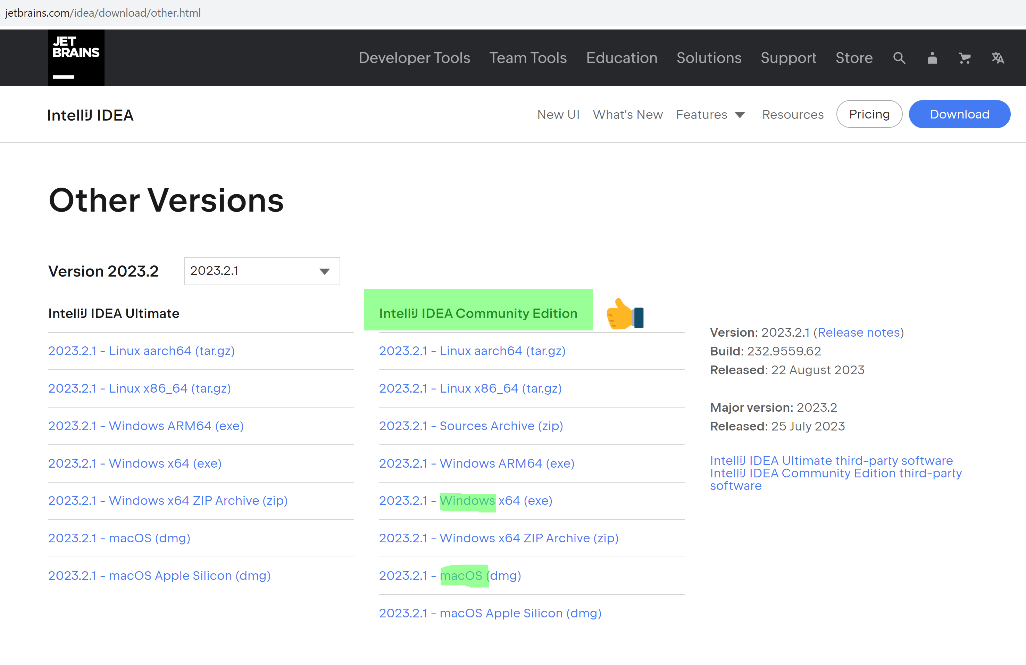
https://www.jetbrains.com/idea/download/other.html
IntelliJ IDEA

Slide 10
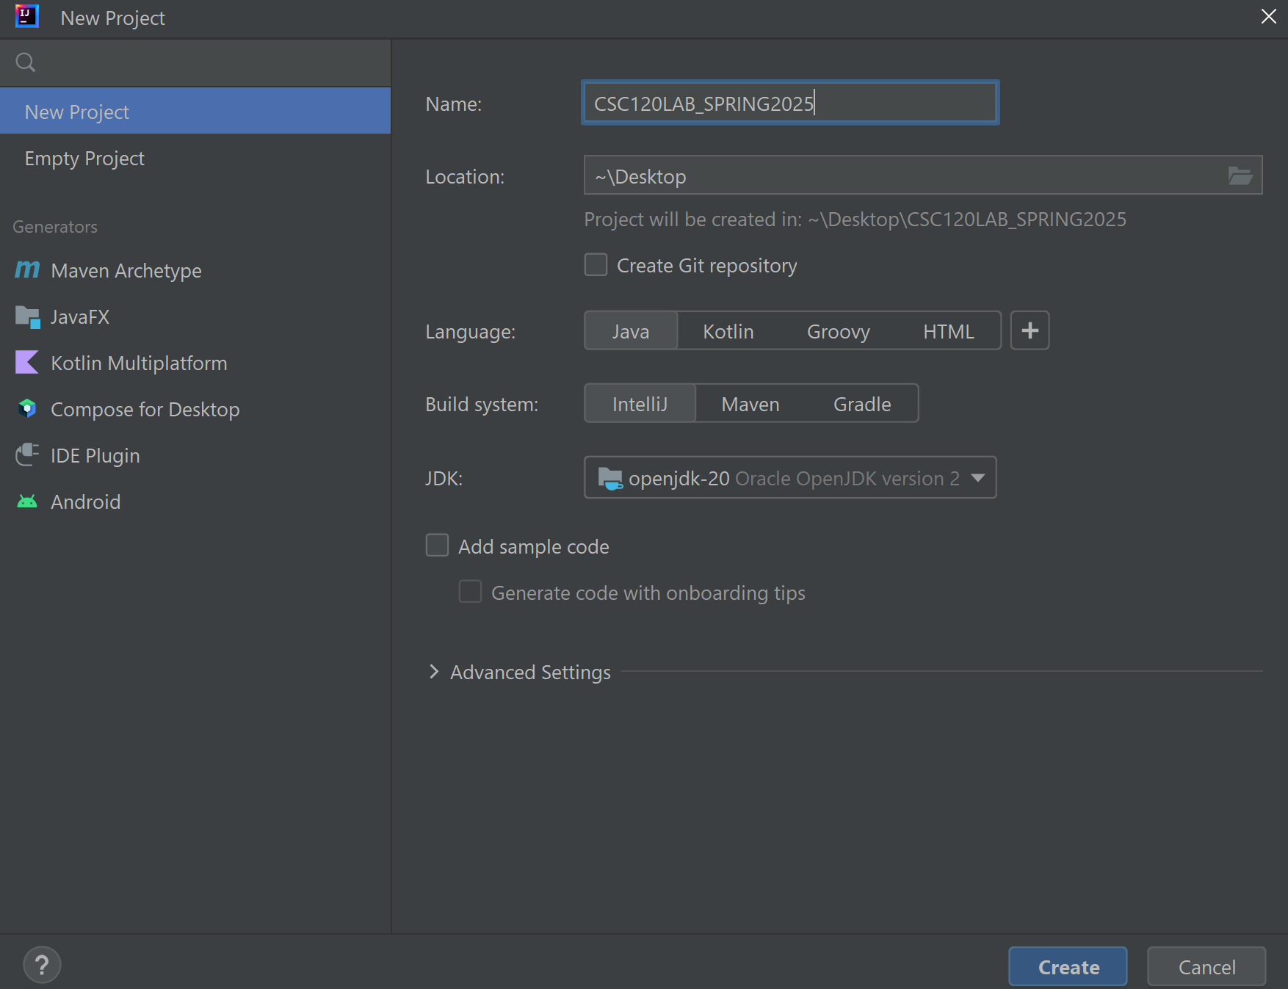
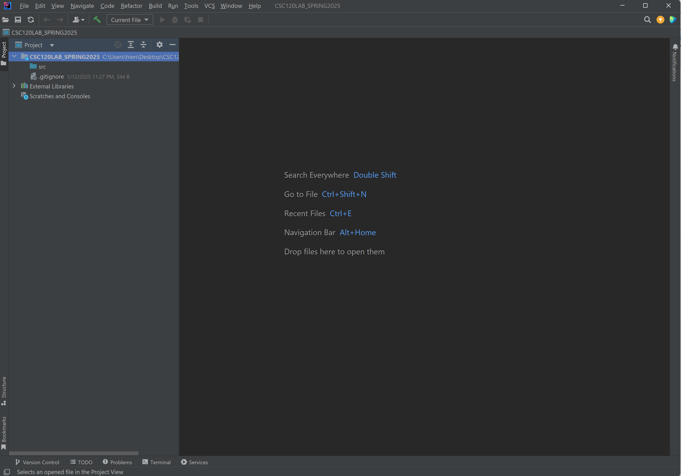
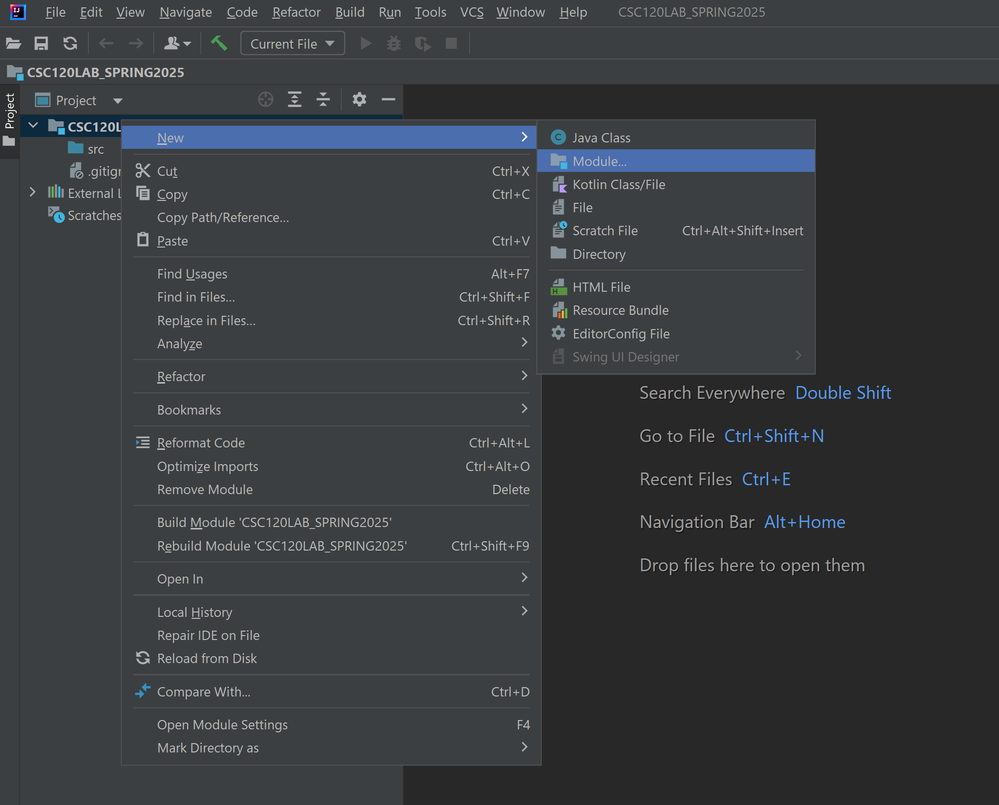
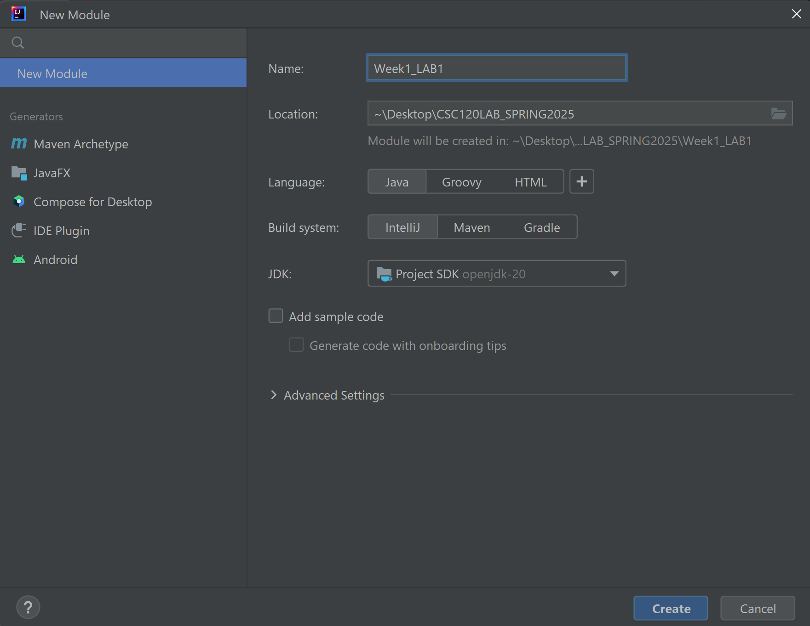
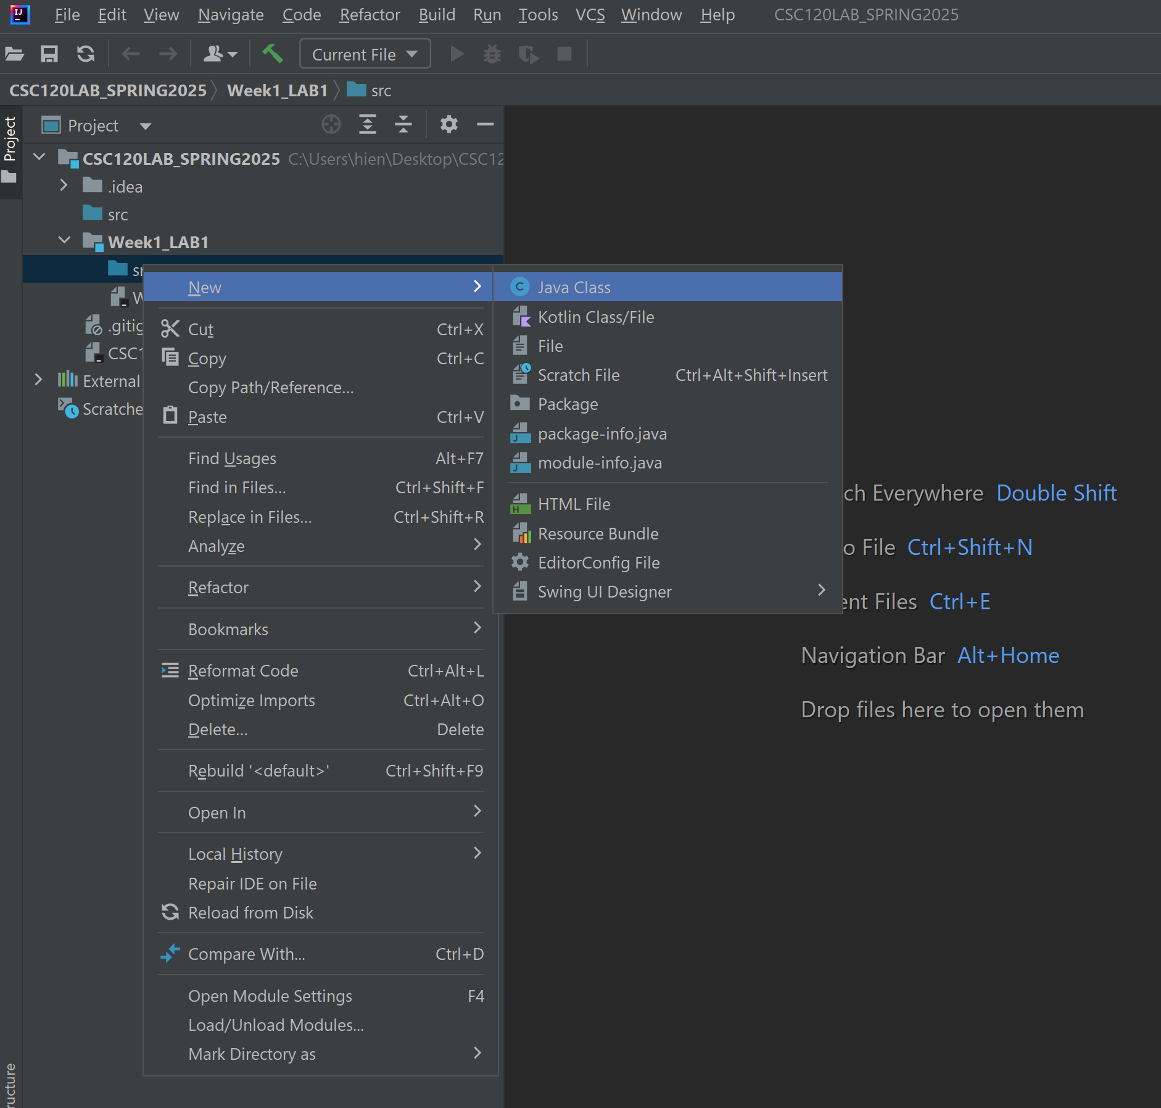
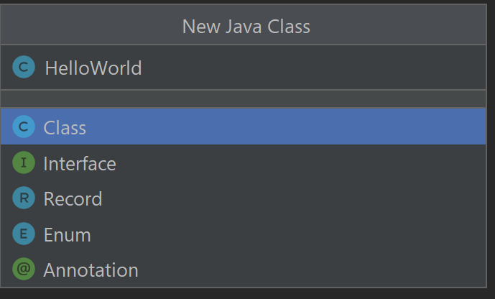
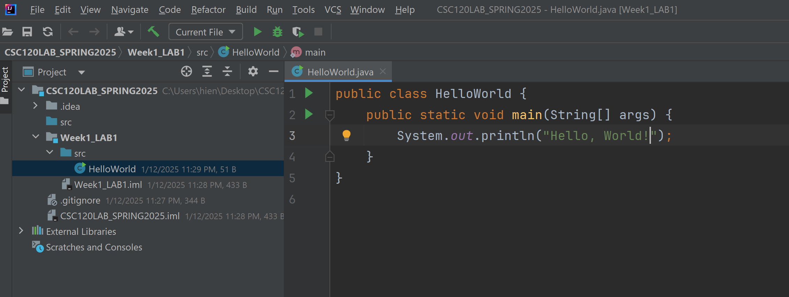
How to Setup Weekly LAB Module
Step 1
Step 2
Step 3
Step 6
Step 4
Step 5
Step 7

Slide 11
TODAY’S LAB

Slide 12
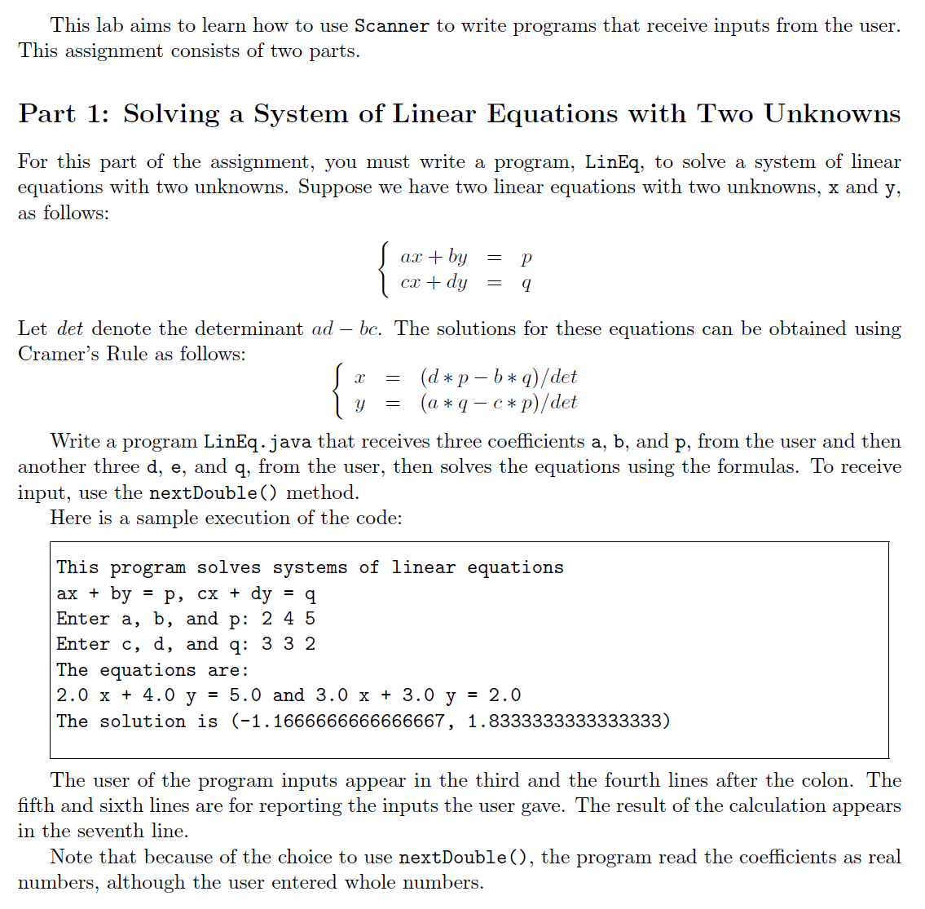
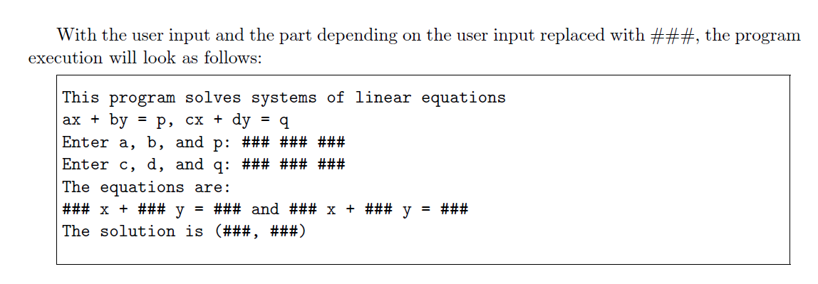
Part 1

Slide 13
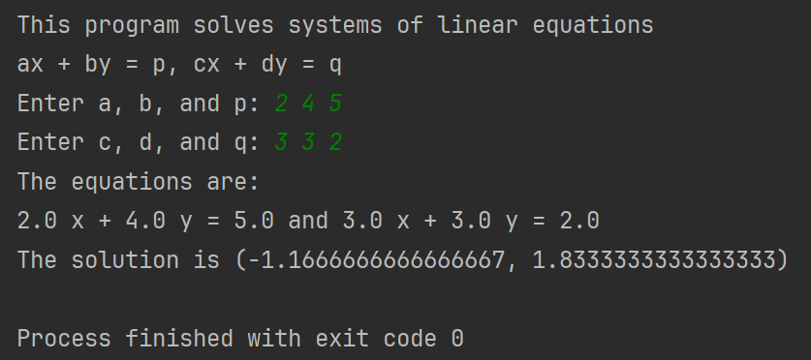
Test Data & Result
Part 1

Slide 14
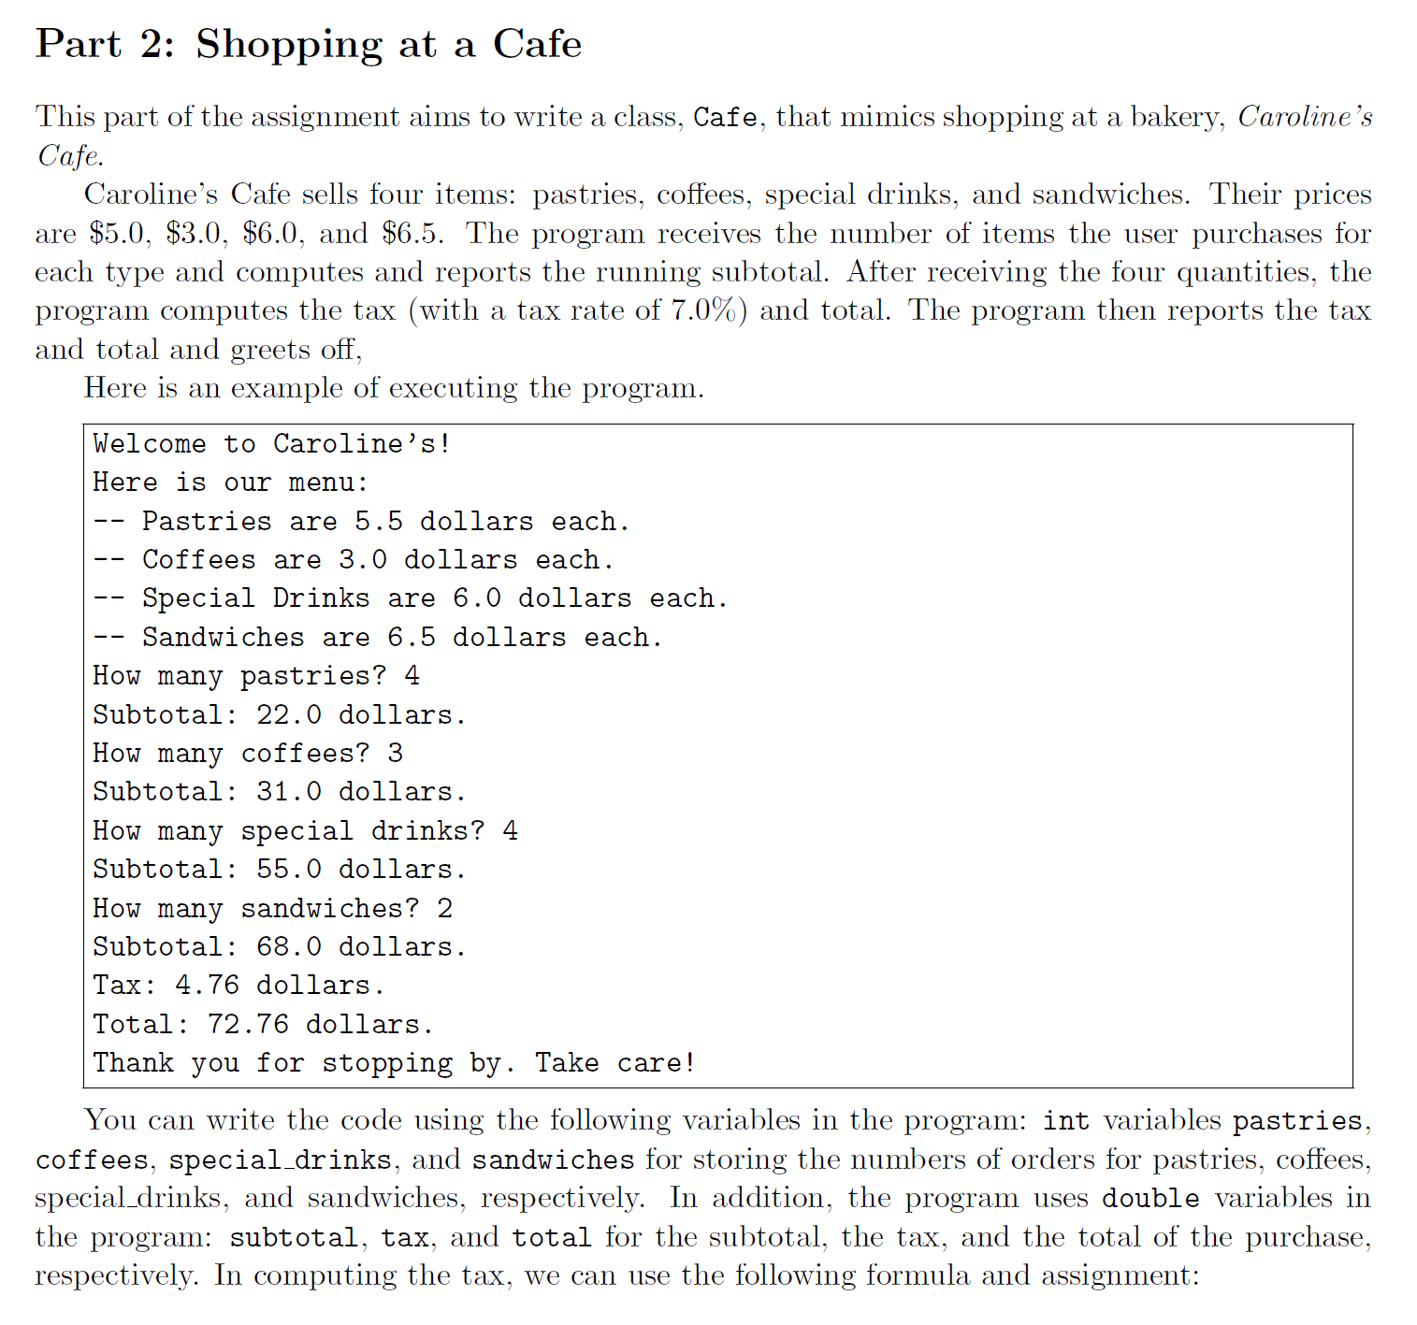
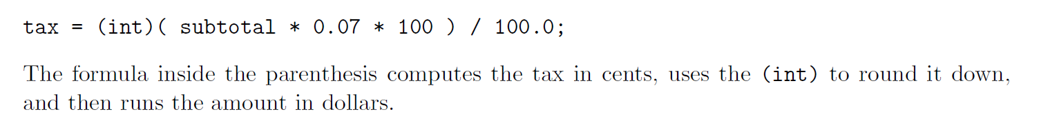
Part 2

Slide 15
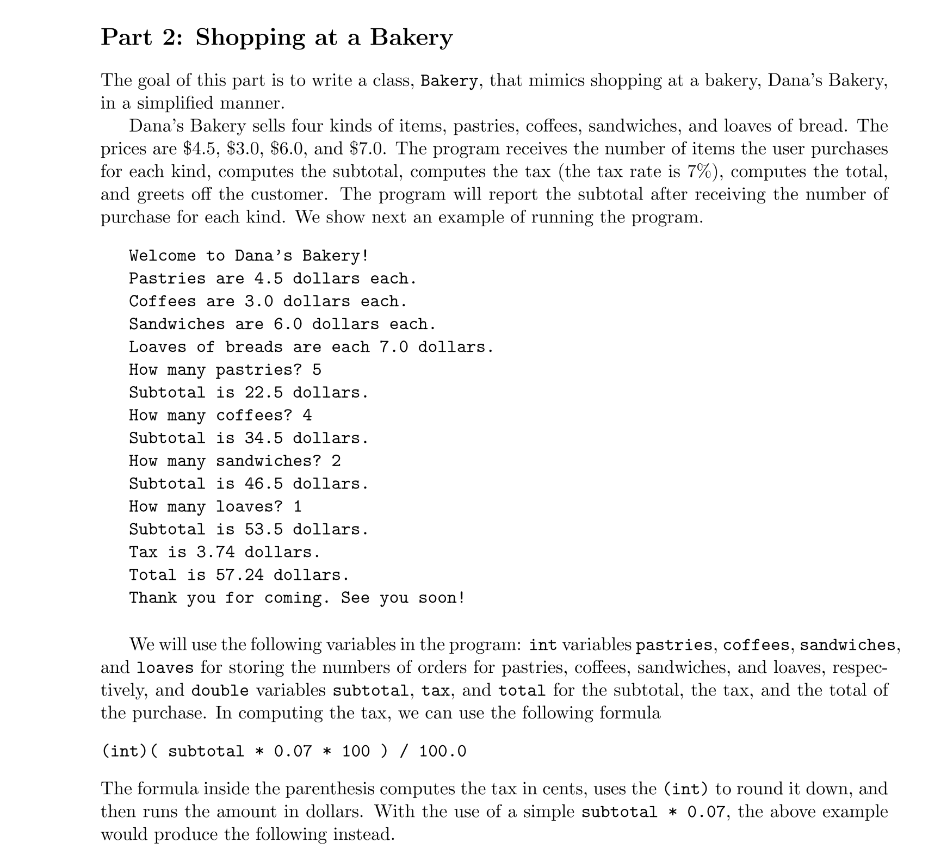
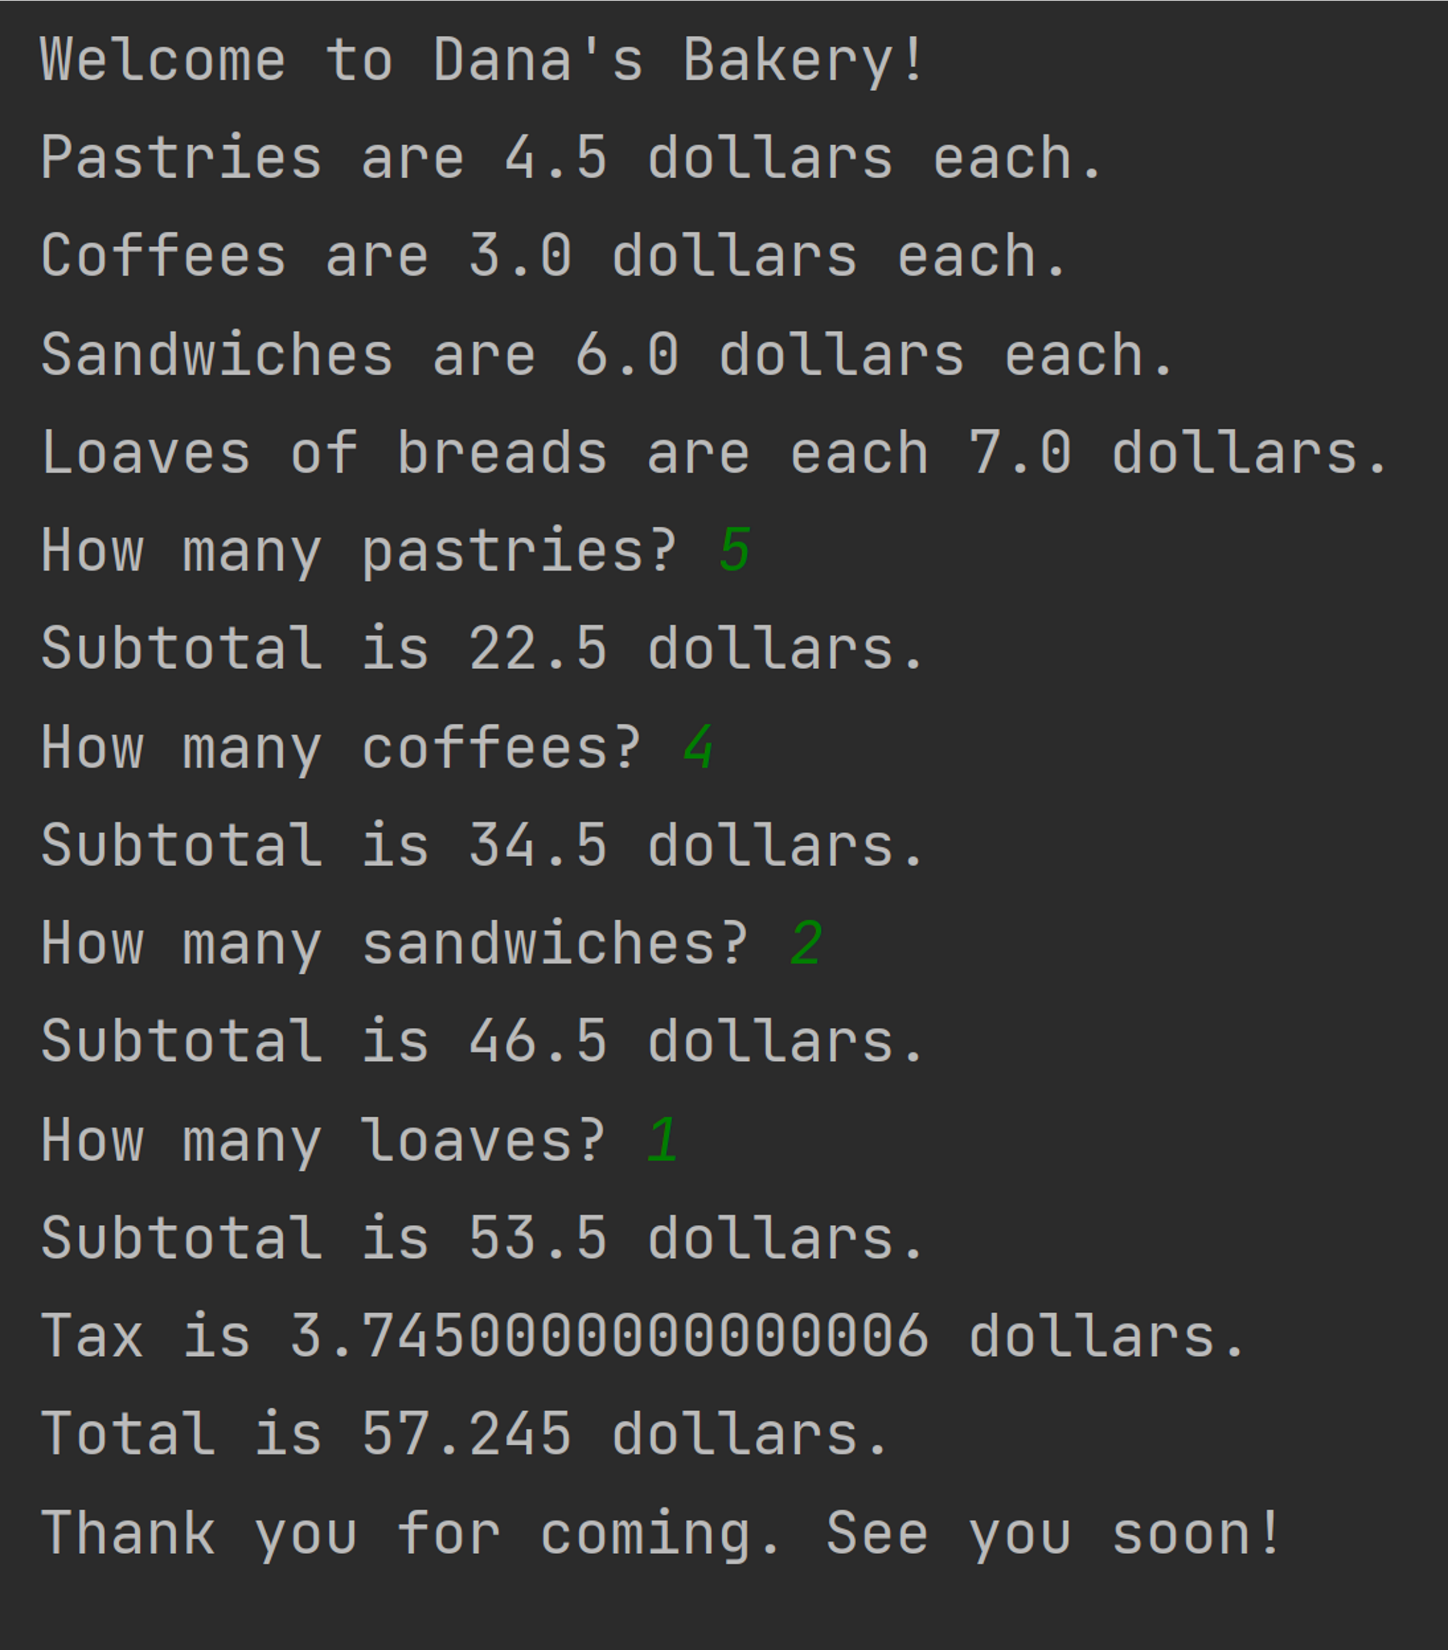

Slide 16
Let’s Begin…

